Slide 1




Python for Data Analysis Project:
Models for estimating Diabetic patient Prediction
Adrien MONTREER
Ryad MIMOUNI - DIA 5

Slide 2
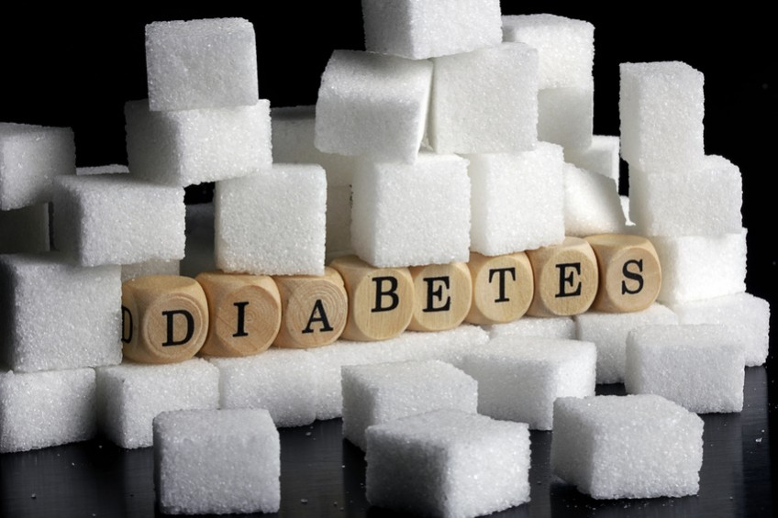

Context and Goals
Global Prevalence of Diabetes
Complications and the Importance of Treatment
Preventive Management and Conclusion

Slide 3
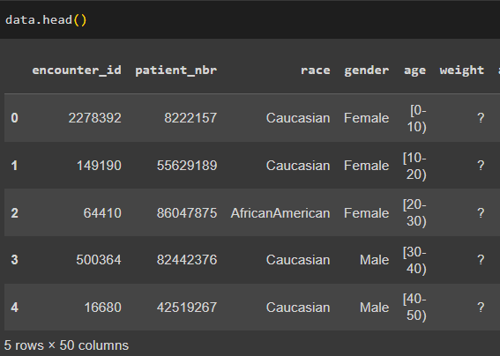
DATASET
Data from US
Size: (101.766*50)
"?" value

Slide 4
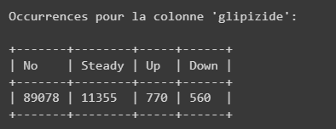
DATASET
Important columns:
encounter_id : id of visit
patient_nbr : id of the patient
Race/gender/age/weight/time_in_hospital
DiabetesMed : the patient have diabetic medication prescribed
admission_source_id : ways of admission of the patient into the hospital
readmitted : the patient was readmitted or not and if readmitted for more or less than 30 days
Columns about medication prescription: No/Steady/Down/Up:

Slide 5
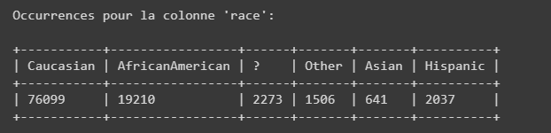
DATASET Visualisation :
Tabulate library
Array:

Slide 6
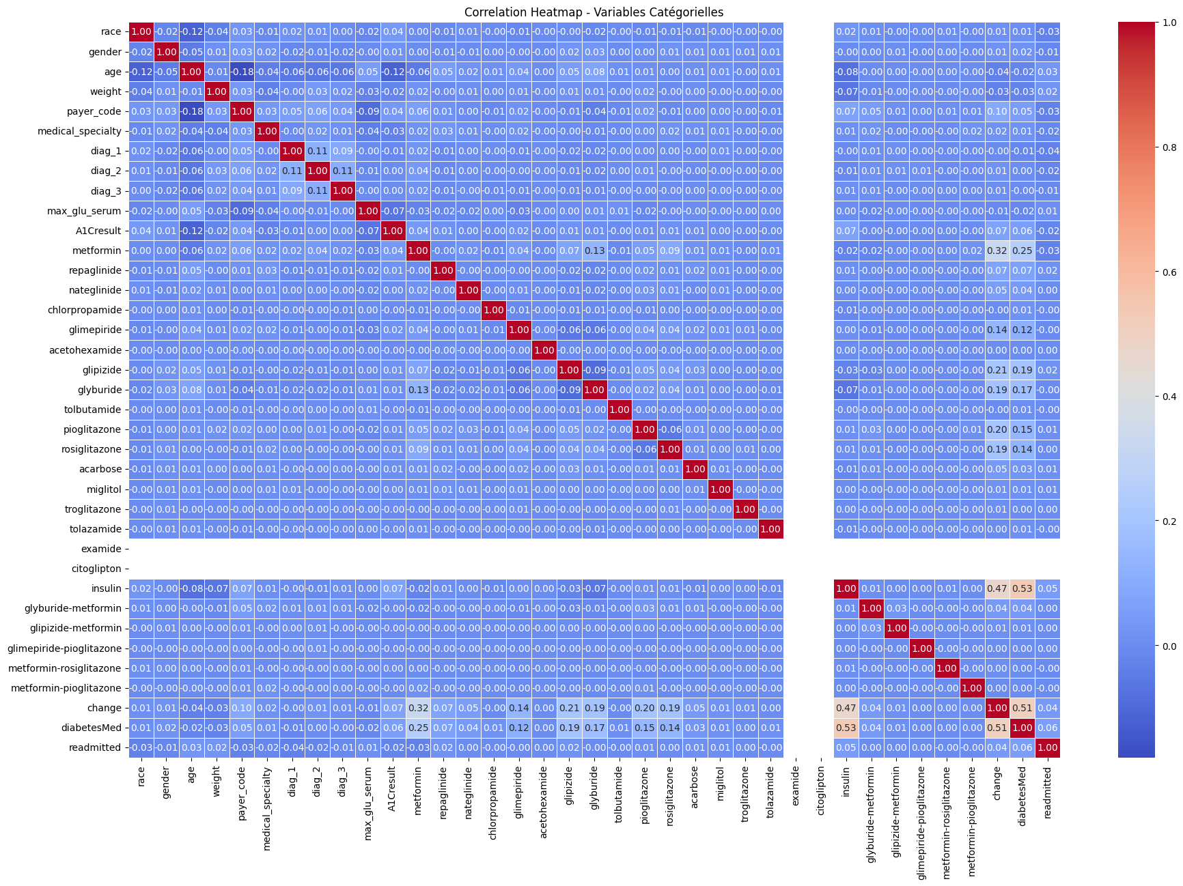

Correlation matrix :
Data Cleanning
z
Nothing to do cause nothing is linked

Slide 7
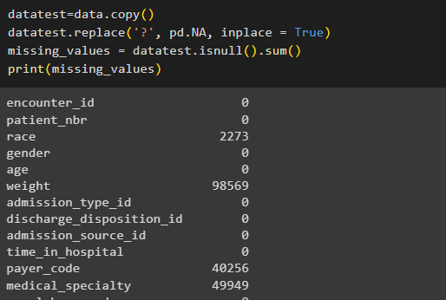

Data Cleanning
- Copy
- replace "?"
- isnull
Weight 97% empty
We can drop this columns

Slide 8
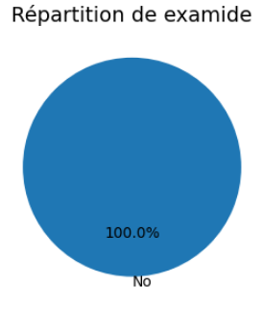
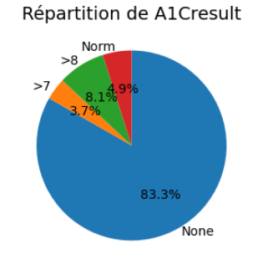
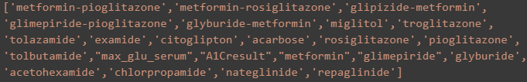
Data Cleanning
Also drop 23 aberrant columns (83% of no)

Slide 9
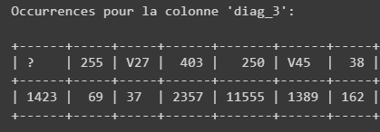
Data Cleanning
Also drop every irrelevant and unusable columns:
DIAG 1/2/3 unusable:

Slide 10
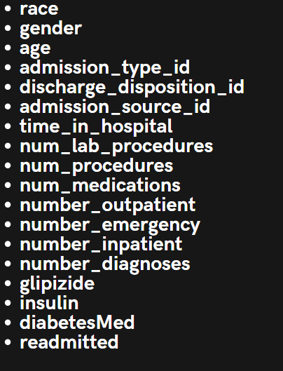
Data Cleanning
18 columns left:

Slide 11
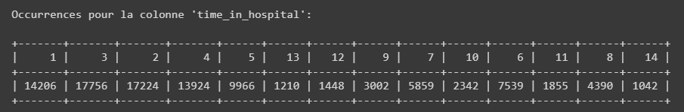
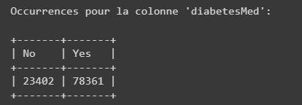
Data Cleanning
Possible target :

Slide 12
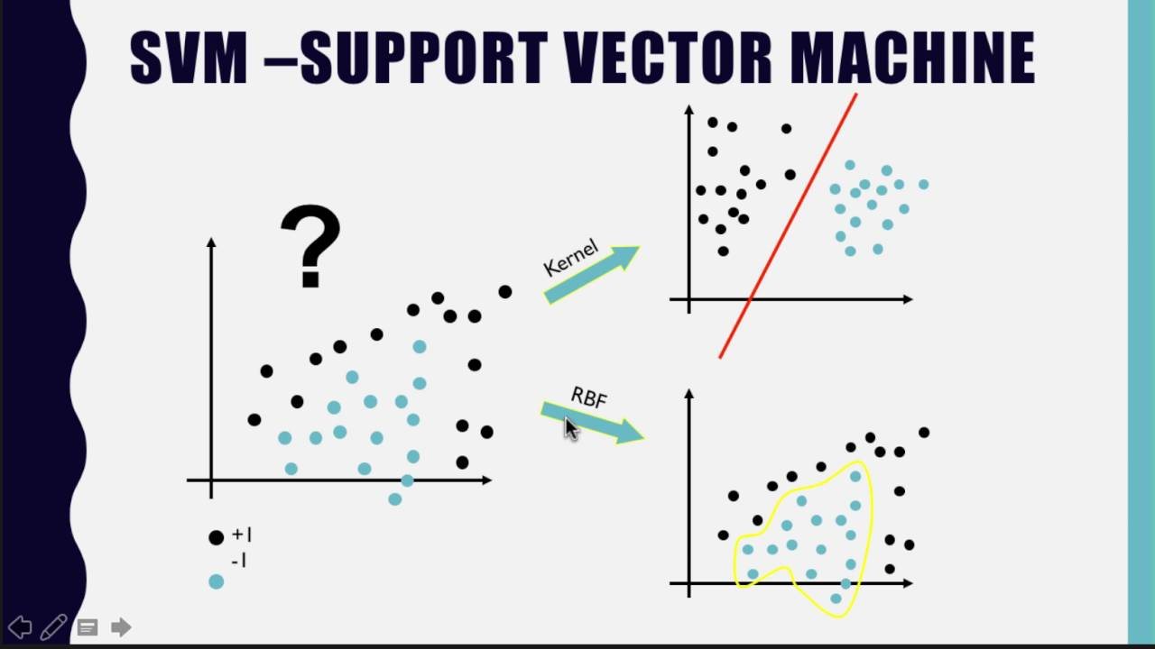
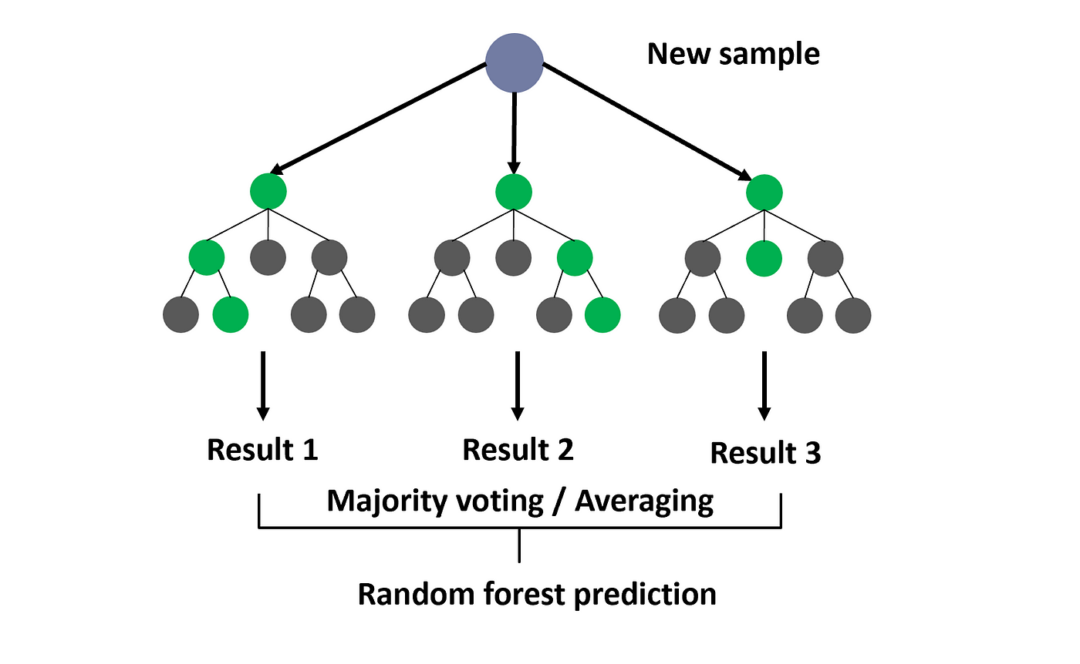
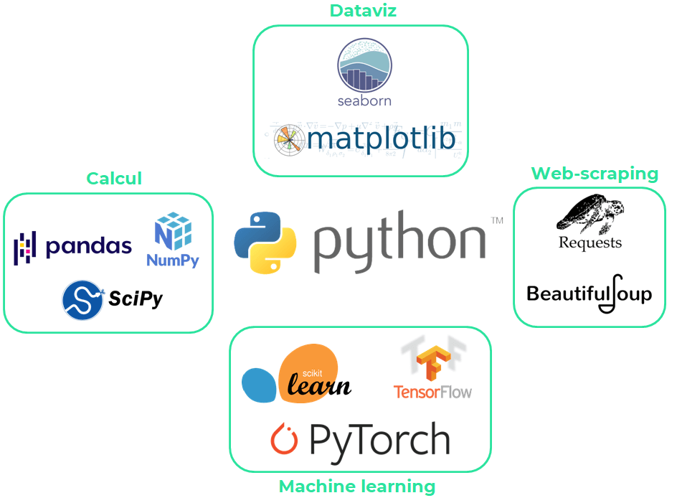
Data Manipulation
Prediction’s Models:
- Random Forest
SVM
80% Train
20% Test

Slide 13
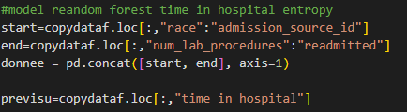
Model Performance for Random Forest
Time in hospital:
Test:

Slide 14
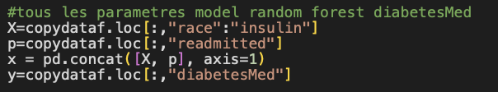
Model Performance for Random Forest
Test:

Slide 15
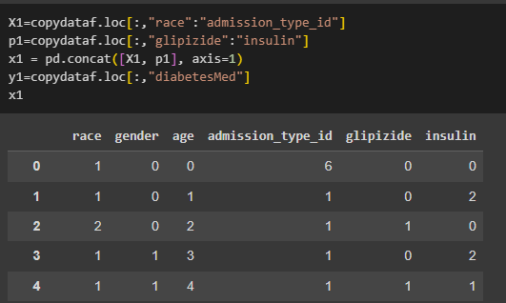
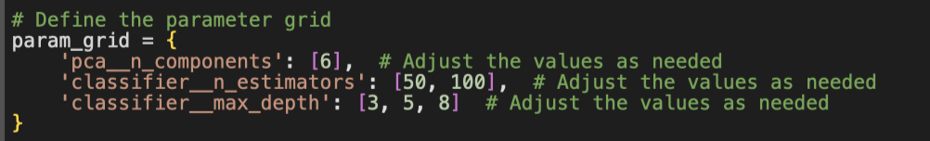
Model Performance for Random Forest
Definition of the parameter grid:
Grid Search:

Slide 16

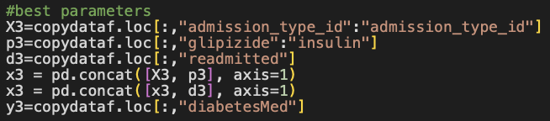
Model Performance
Random Forest:
SVM:

Slide 17
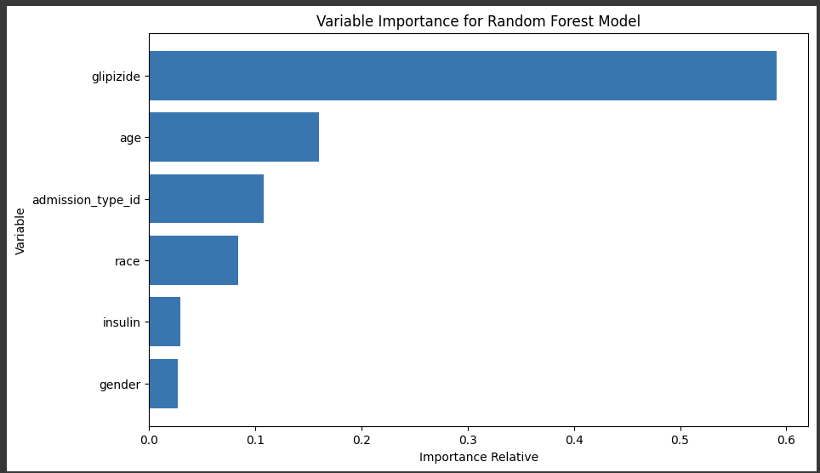
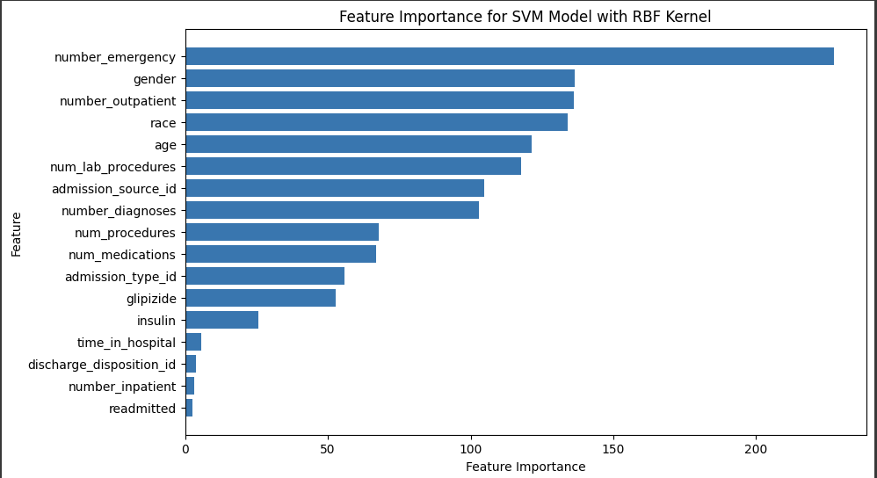
Most Useful Variables for the Models
Random forest uses fewer variables to build its model
SVM uses and exploits many more variables

Slide 18
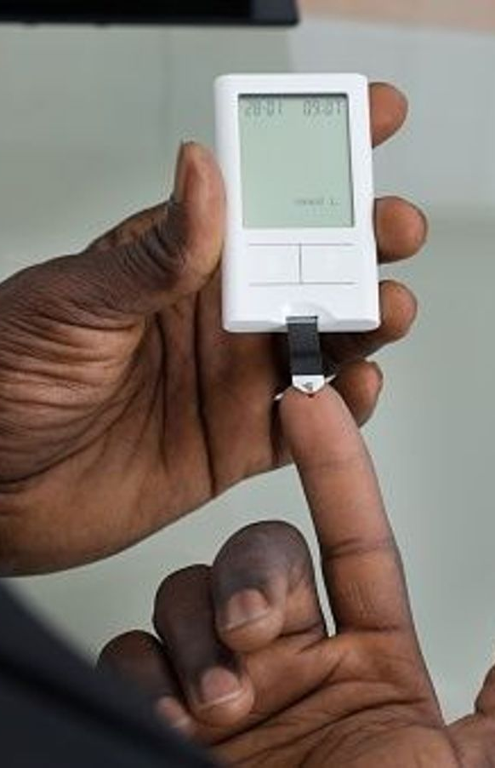
CONCLUSION
Early Risk Identification
Personalized Prevention and Management
Fairly accurate and fast diagnosis
Awareness and Ongoing Education
Accessibility for everyone

Slide 19

Adrien MONTREER Ryad MIMOUNI DIA 5
z

